Slide 1
Block and Lock using gene silencing
Tony Kelleher | 25th July, 2018

Slide 2
Conflicts of interest
Inventor on patents regarding Promoter targeted siRNAs
Calimmune /CSL has provided one of the retroviral backbones for delivery and expression of sh/siRNAs used in the SCID Hu Mouse experiments
Acknowledgments
Patients from whom the primary viral isolates have been characterised that provide the Env and Vpx constructs that are detailed in the second half of the talk

Slide 3
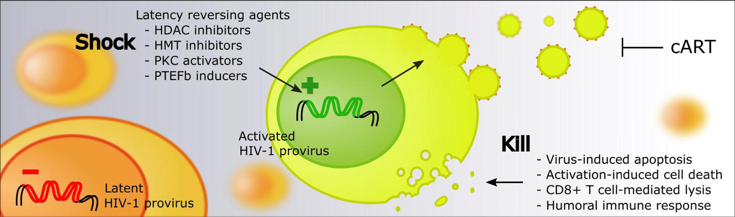
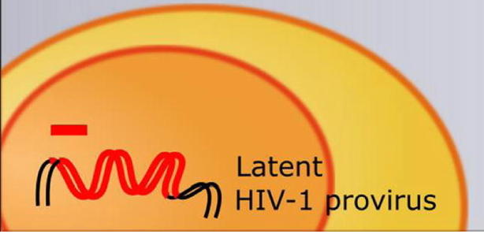

HIV cure strategies
Eradication vs Functional: “Shock & Kill” or “Block & Lock” ???
ART
Kill
Latency inducing agents
- siRNA
- shRNA
- dCA
ART may not be required
Super Latent HIV-1 provirus
Block
Lock
- Tat Nullbasic
- RNA-induced super latency
- maintain epigenetic silencing
- resist reactivation
stimuli
Notes:
Fundamental limitation of ART is, it’s not a cure. It has no impact on the latent reservoir.
dCA didehydro-Cortistatin A,

Slide 4
The virus in the reservoir is in a Latent state
Block and Lock using Gene Silencing: IAS 2018
Post-integration Latency
DNA form of the Virus is not transcribing: not making RNA
  gene expression is driven off promoters: in HIV this is the 5’LTR
Mechanisms of latency:
  Integration into silent genes
    HIV tends to integrate into active genes
    active genes may become silent as cell differentiates or becomes resting
  Epigenetic silencing
    change in histone architecture of the 5’LTR: deacetylation and methylation of histones
    sequestration of host (Transcription Factors) and/or viral factors (Tat) that regulate viral transcription
  viral promoter competition with host gene
  defective virus
    may not be replication competent, unable to transcribe

Slide 5
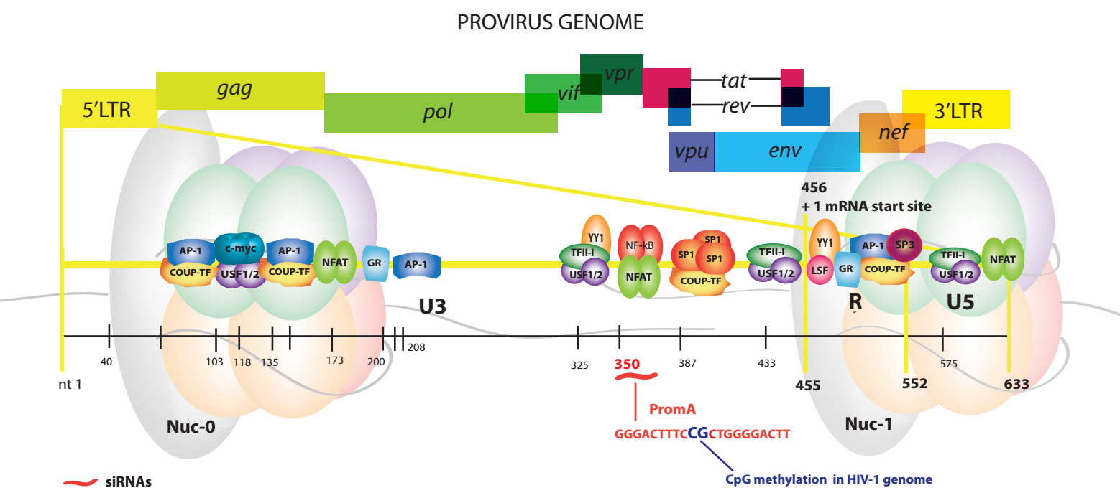
Control of Proviral Transcription
Importance of 5’LTR
LTR : binding sites for Tat and host transcription factors
histone methylation: closed/compacted chromatin
histone acetylation: open/accessible chromatin
Mendez et al, 2015

Slide 6
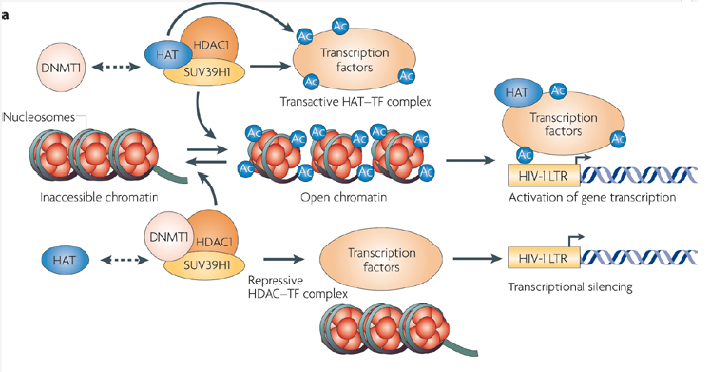
Block and Lock using Gene Silencing: IAS 2018
Epigenetic regulation of viral latency
Rearrangement of Nucleosome architecture
open, acetylated chromatin
X
closed, methylated chromatin
Coiras et al, 2009 Nat. Imm

Slide 7
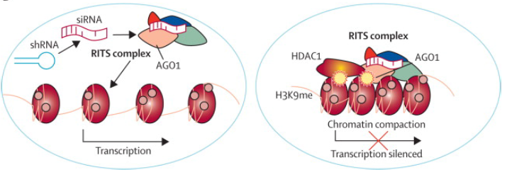
Gene therapy for drug free remission of HIV
HIV Functional cure: enforcing viral latency
“BIND and GAG” or “BLOCK and LOCK”
Gene therapy: si/shRNA which target sequences within HIV promoter
Induces long term lock down of virus in latent form, by inducing change in histone tails and nucleosome architecture, resistant to a range of reactivation stimuli
viral replication
viral replication stopped
Ahlenstiel et al, 2016

Slide 8
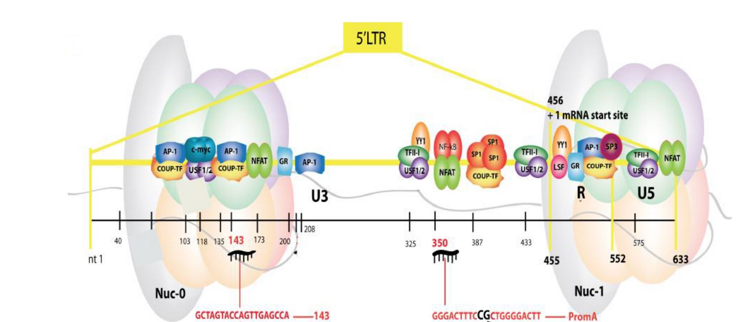
HIV-1 Promoter siRNA transcriptional silencing targets
siPromA: targets the unique, tandem NF-κB binding motif
si143: targets region adjacent to AP-1/COUP-TF motif
both have sequences that differ from those in the human genome, but conserved in HIV-1
allows multiplexing
H3K9Ac
H3K9Ac
si143
siProm A
Mendez et al, 2015

Slide 9
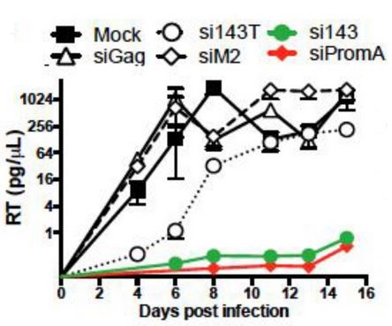
siPromA/143 are highly specific & potent HIV-1 suppressors
siRNA | Target HIV-1 _{NL4-3} strain sequence
siPromA | GGGACTTTCCGCTGGGGACTT
siM2 | GGGACTTTAAGCTGGGGACTT
siScrambled | AAGCTGGGACGTGTGCCTGTT
si143 | GCTAGTACCAGTTGCGCCA
si143T | GCTAGTACCAGTTGCTCCA
siPromA- & si143-transfected cells suppress HIV-1 transcription
mutated si- & siScrambled-transfected cells do not suppress virus
suppression is profound (≥3 log₁₀ of viral RNA) and prolonged
effective in a range of cells: Magic, HUT 78, Jurkat, Monocyte derived Macrophages,
no clear off-target effects
Suzuki et al., RNA Biology 2011; MTNA 2013; Ahlenstiel et al., NAR 2012; MTNA 2015; Klemm et al., Genes 2016

Slide 10
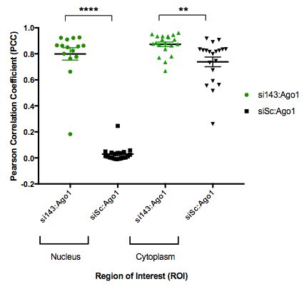
5‘LTR targeted siRNA specifcially migrate to the nucleus in HIV-1 infected astrocytes and supress infection
Block and Lock using Gene Silencing: IAS 2018
siPromA si143
→ siPromA and si143 but not siScrambled co-localises with Ago1 in the nucleus of HIV-1 pseudovirus infected SVG astrocytes
→ siPromA and si143 mediated silencing of HIV-1 infected SVG astrocytes follows the transcriptional gene silencing pathway (TGS)
Fictcher and Ahlensteil

Slide 11
Block and Lock using Gene Silencing: IAS 2018
siPromA/si143 induce viral latency resistant to reactivation by a range of LRAs
+
shPromA, sh143 and dual-transduced J-lat 9.2 cells resist reactivation induced by a panel of LRAs
correlates with maintenance of heterochromatin epigenetic profile
Notes:
Fundamental limitation of ART is, it’s not a cure. It has no impact on the latent reservoir.

Slide 12
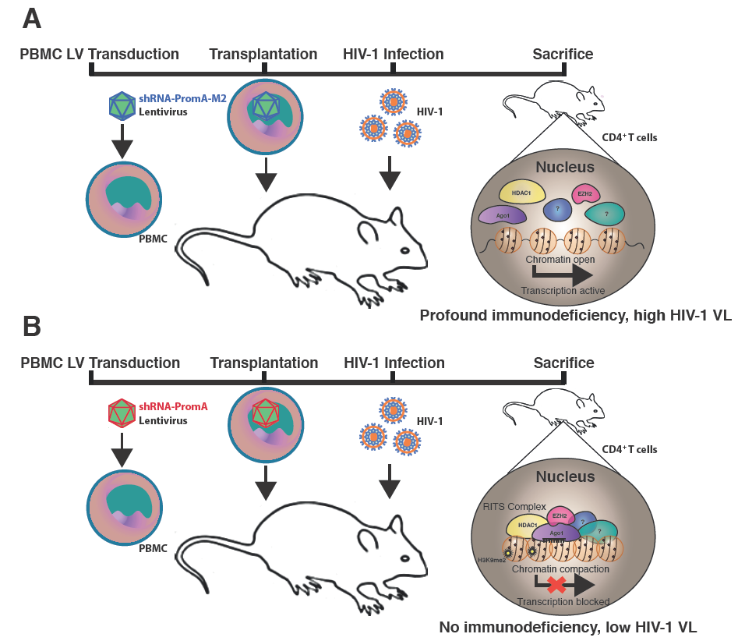
Preclinical mouse data in humanised acute HIV mouse model
Susceptible to HIV
Protected against HIV
Reconstitution of SCID-humanised mice with shPromA-transduced PBMC or CD34 stem cells suppresses acute HIV-1 infection
Suzuki et al., MTNA 2013; Ahlenstiel et al., Frontiers in Immunology Review 2015

Slide 13
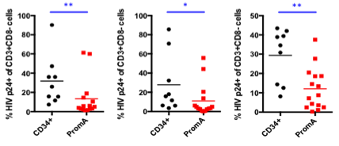
Preclinical mouse data in humanised acute HIV mouse model
Block and Lock using Gene Silencing: IAS 2018
PBMC
Spleen
Bone Marrow
Reconstitution of SCID-humanised mice with shPromA-transduced CD34⁺HSC suppressed acute HIV-1 infection
Similar results with SCID-humanised mice reconstitued with shPromA-transduced PBMC
Degree of suppression correlates with degree of expression of siRNA
Tsukamoto, Kariya , Okada, Suzuki

Slide 14
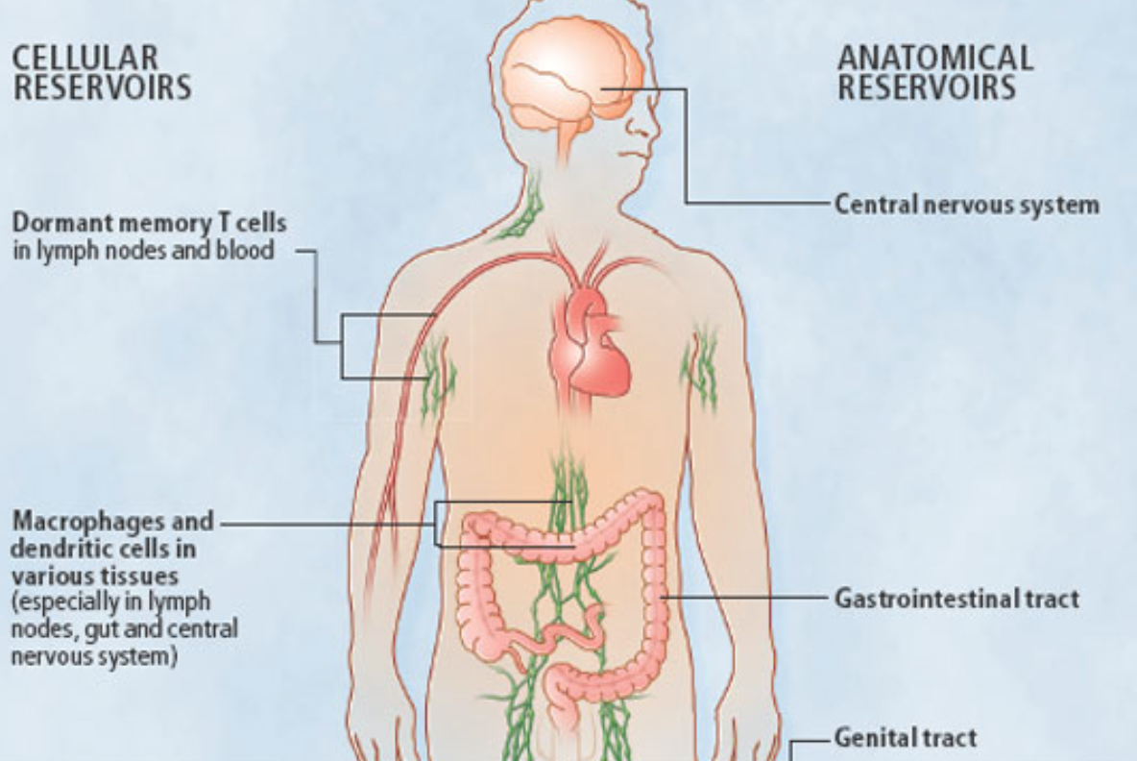
Where is the Reservoir?
Block and Lock using Gene Silencing: IAS 2018
Cellular reservoirs
T cells: all CD4+ T cells
  varying contribution of subsets
  Memory: Central > Transitional
    Effector Memory cells
    Stem Memory cells, small reservoir, but persist
    Follicular T helper cells (Tfh) in lymph nodes
  Naïve: smaller contribution
these cells are resting not activated
Monocytes/macrophages & DC
Tissue reservoirs
  Brain: Microglia, Astrocytes
  Gut/Genitourinary tracts
Stevenson, 2008

Slide 15
Gene therapy in HIV infection requires effcient delivery to the reservoir
Manipulation of the reservoir requires delivery of genes into resting T cells
Resting T cells have low endocytosis and do not carry VSV-g receptor
Highly challenging:
  VSV-g pseudotyped retroviral delivery is limited, needs activation of cells or ways of avoiding viral restriction factors
  must be done ex vivo, complex expensive GMP procedures
  needs to deliver gene therapy to cells without clear marker of their being latently infected
  need to access small, difficult to access and find reservoir
Potential solutions:
  Retroviral delivery: build new retrovirus expressing broadly tropic HIV-1 gp120 instead of VSV-g and HIV-2/SIV Vpx
  Use nanoparticles
    allows multiplexing
    may allow in vivo rather than ex vivo treatment, with bulk synthesis
    potentially better safety profile

Slide 16
Lentivirus targeting Resting CD4⁺ T Cells
Lead Envelope
Lentiviral (HIV-1/B)
Dual-Tropic
Low-CD4 Dependence
Very efficient vector delivery
to a range of Resting T cells
n=8
Wong and Turville, Abstract # TUAA0205
Notes:
Do we want to mention Spln7 at this point? I’d prefer to keep the name masked.

Slide 17
Vpx Improves Transduction Outcomes
No Vpx
Vpx
n=3
n=5
Vpx from different HIV-2/SIV strains have different transduction efficiencies
Certain Vpx sequences improve transduction of both resting T cells and Macrophages to a similar extent
Wong and Turville, Abstract # TUAA0205
Notes:
Here we can talk about how Vpx treatment. increases transduction.
Vpx variant here is SIVmac239
1 Key observation about this data: There is a period of time where cells are still vulnerable to infection following Vpx delivery.
So, we turned to looking at other Vpx variants.

Slide 18
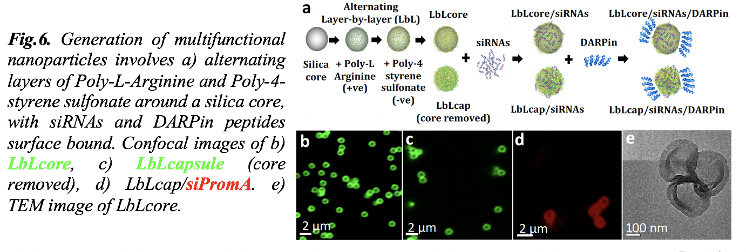
Nanoparticle preparation- Layer by layer
Layer by Layer (LbL) built around 900 nm silica particle (electrostatic interactions)
Layer 1-3-5-7: Poly-4-styrene sulfonate (-ve charge)
Layer 2-4-6-8: Poly-L-Arginine (PLArg) (+ve charge)
Negatively charged siRNA adsorbed to PLArg
Arginine provides cell penetration properties
core capsule cap with siRNA tem
Björnmalm et al. Nanoengineering Particles through Template Assembly (2016)

Slide 19
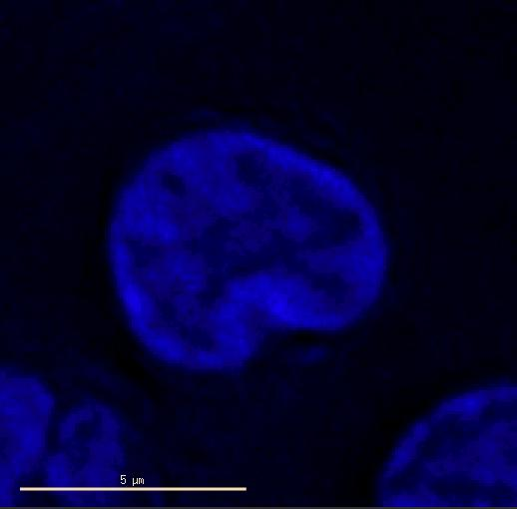
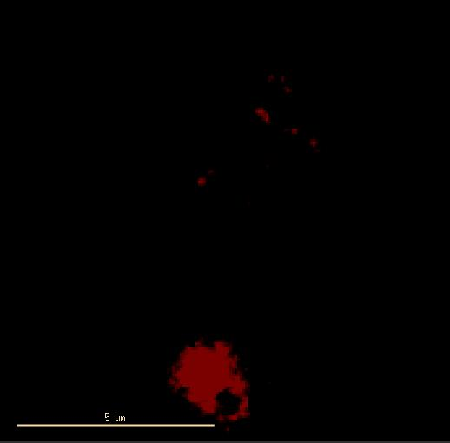
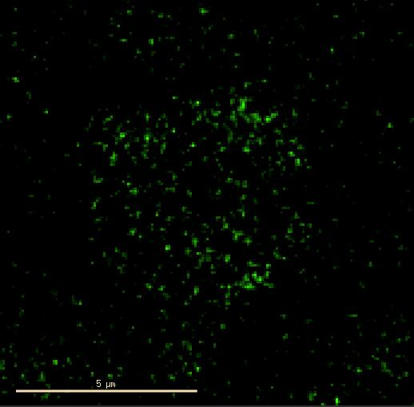
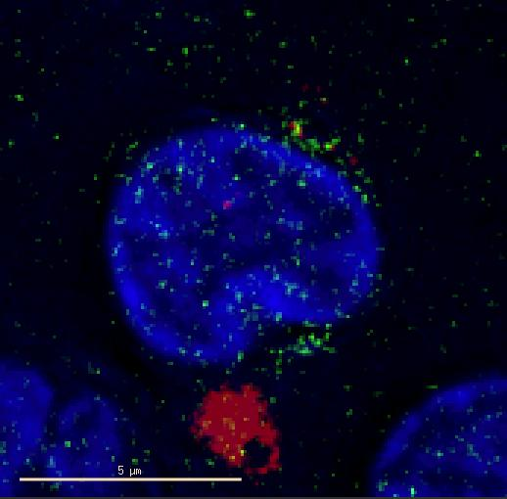
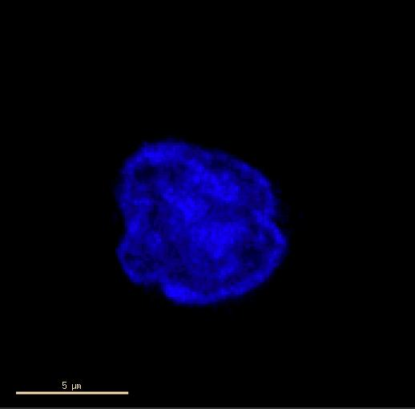
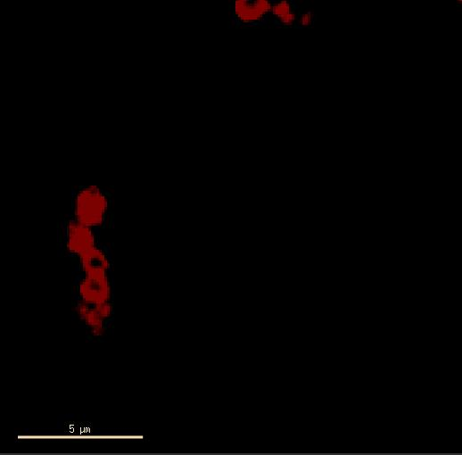
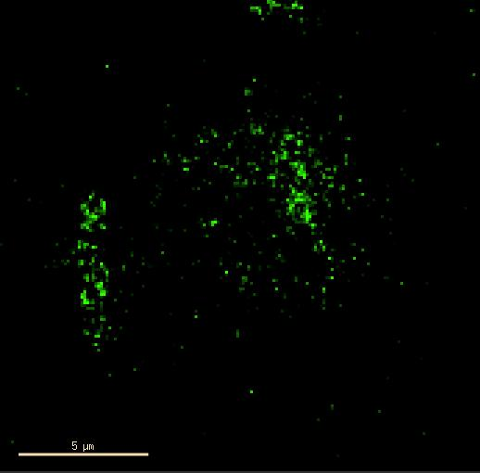
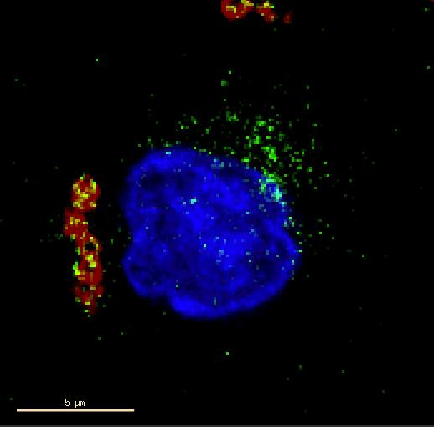
Resting CD4+ T cells
Arbitrary Line Intensity Profile
NucBlue
siPromA
HIV-1_{NL4.3}-GFP
Merged
siPromA
siPromA
siScrambled
siScrambled
siPromA delivered to nucleus to 15% of HIV-1 infected resting CD4+ T cells using untargetted NP
Klemm, Ahlenstiel, Czuba,,Cortez-Jugo,Caruso

Slide 20
Conclusions
si/shRNAs targeting conserved regions of the HIV-1 promoter induce prolonged, profound & specific silencing
  in a range of cell types
    T cells
    MDM
    Astrocytes
  - induced latency is resistant to T cell activation: Superlatency
Any gene cargo needs to to be efficiently delivered to the reservoir especially resting T cells
    existing approaches are inefficient: we have chosen to Modify The Vector, Not The Cell
    Promising results from
      engineered retrovirus carrying specific env (>80% of untouched CD4⁺ T cells) and Vpx, 40%+ transduction efficiencies observed using lower MOI for transduction (MOI=0.04, important for upscaling)
      LBL Nanoparticles: may have advantages for siRNA multiplexing and use for direct in vivo delivery
BLOCK
LOCK
DELIVER

Slide 21
Acknowledgements
Kirby Institute, UNSW
Vera Klemm
Chantelle Ahlenstiel
Christina Fitcher
Scott Ledger
Kazuo Suzuki
Andrew Wong
Stuart Turville
Anupriya Aggarwal
Bailey Hao
Hugh McRae
Orvin Atthi
T. H. Chan School of Public Health, Harvard University
Phyllis Kanki
Donald Hamel
Bobby Brooke Herrera
Chemical Engineering,
Melbourne University
Ewa Czuba,
Christina Cortez-Jugo
Frank Caruso
Burnet Institute, Monash University
Lachlan Gray
Royal Melbourne Institute of Technology (RMIT)
Paul Gorry
Melissa Churchill
Kumamato University
Tetsuo Tsukamoto
Seiji Okada
Funding: NHMRC (Australia):
Program Grant: NP work
Project Grants: development of siRNAs

